Slide 1
Investigating the Causal Effect of
Extreme Heat (T) on
Respiratory Disease Mortality(Y)
Archy(Yaqi) Guo (yg3481)
Ruolin Wu (rw3763)
Linuode Ye (ly2549)
12/19/2024
Instructor: Takahiro Yabe

Slide 2

Research
Question
P A R T 0 1

Slide 3

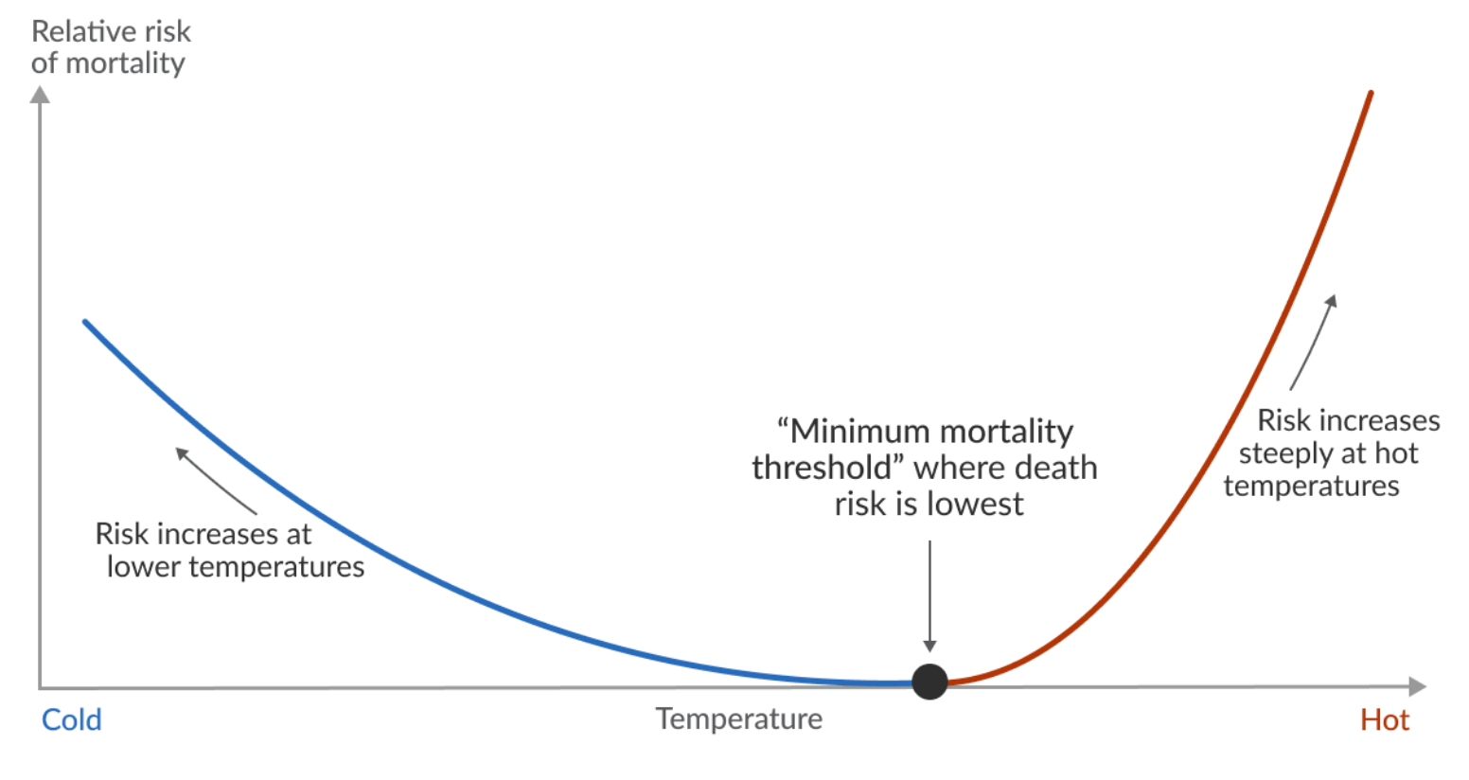
Background
X
Causal Model
T - heat wave days
Y
respiratory
death
Continuous variables
Continuous variables

Slide 4
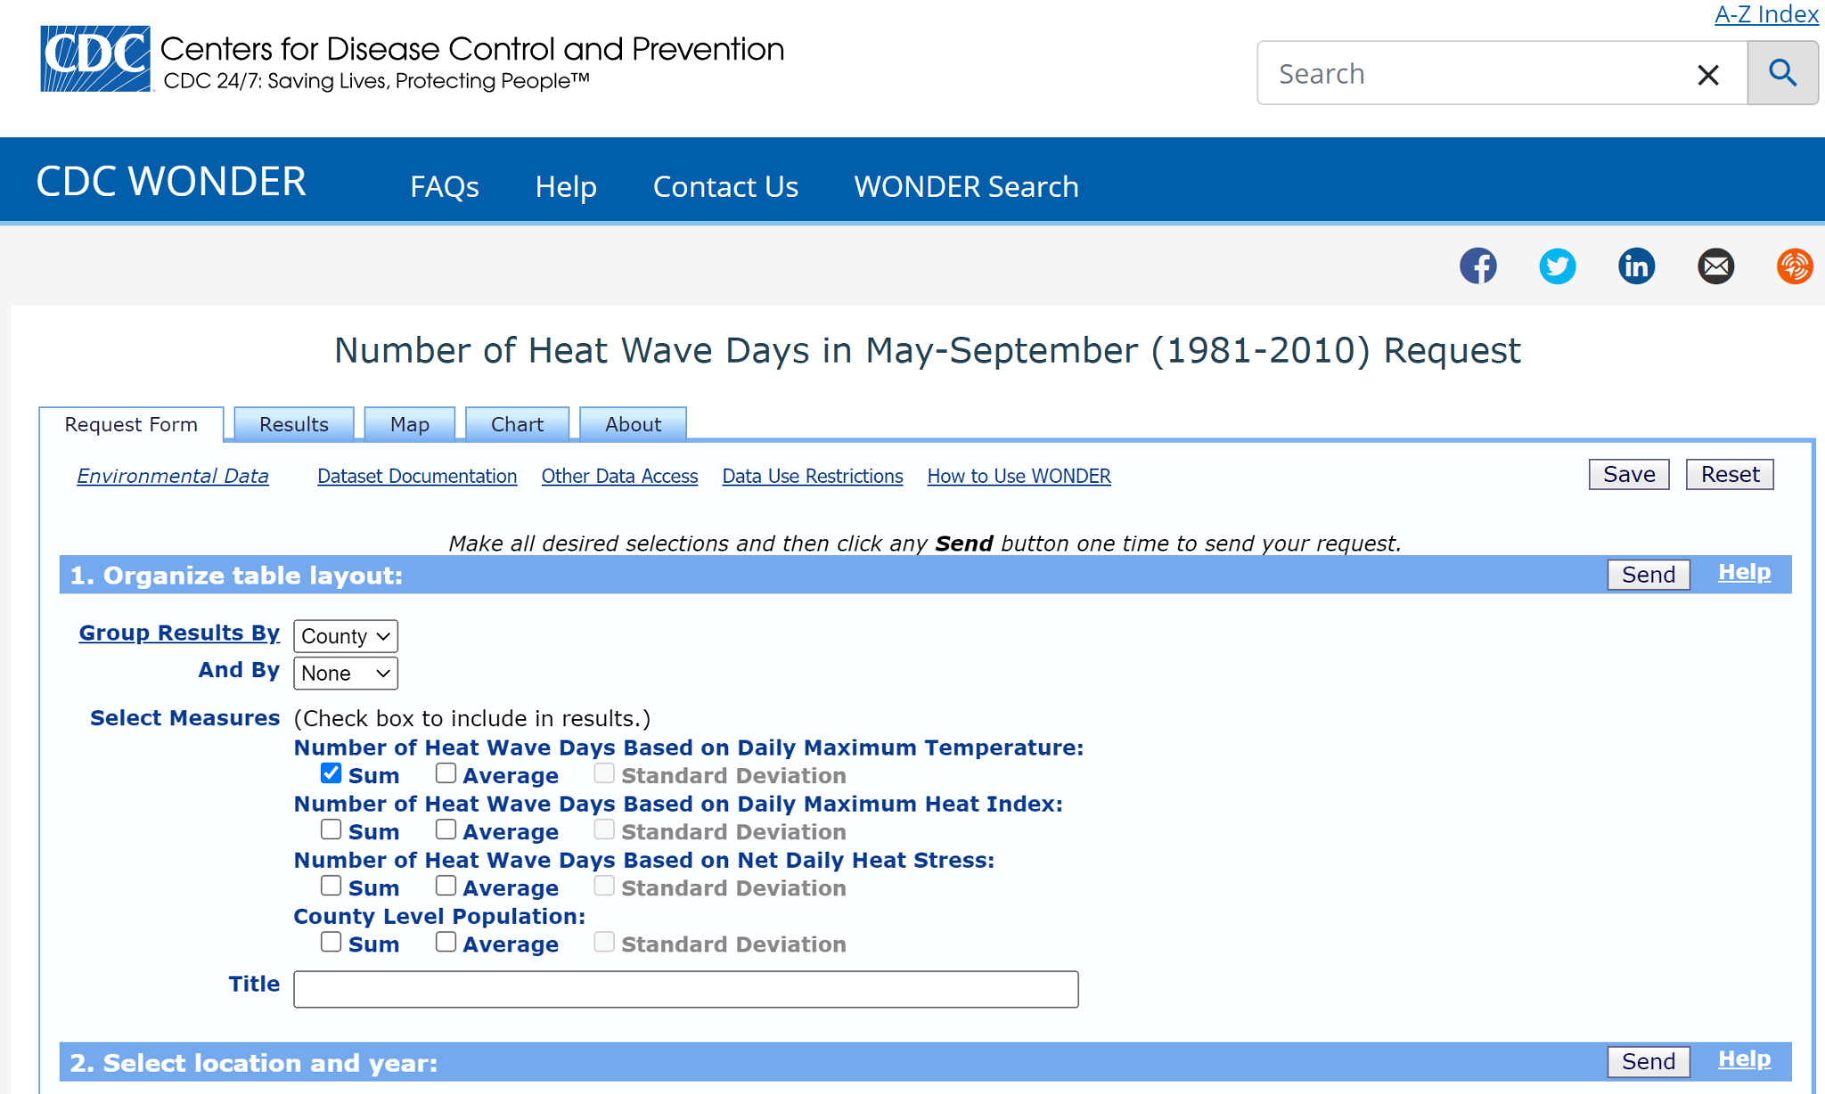
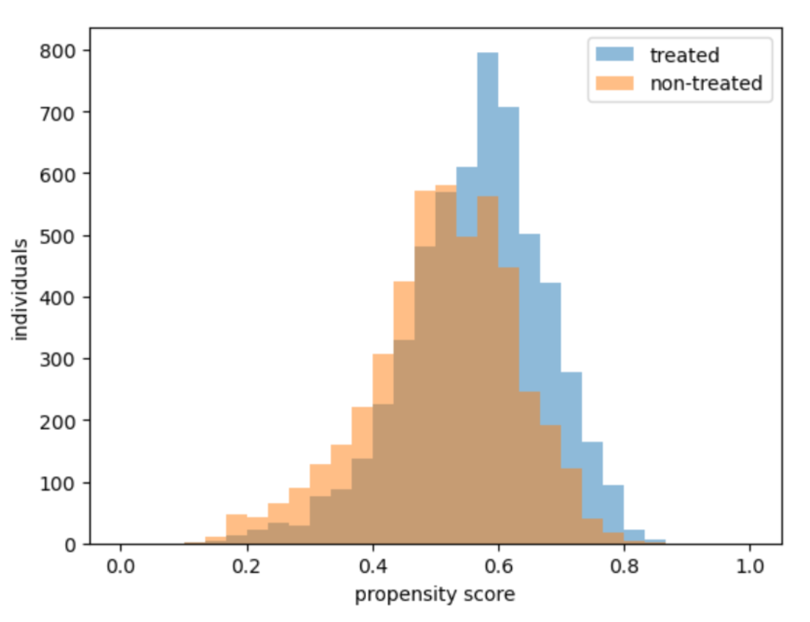
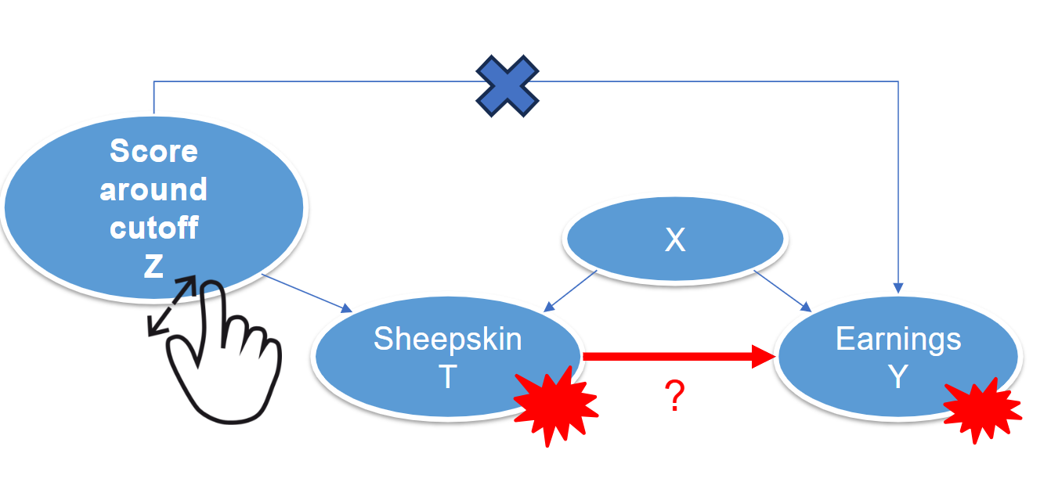
Methods
&
Results
P A R T 0 2
DATA
IPW
IV

Slide 5
Data
Several considerations on data:
Geospatial data -> ‘county_code’
Normalize ‘Respiratory Deaths’ by ‘Population’ -> ‘crude_rate’
County level -> 3000+ counties
2005~2010
-> Why years?
X
T: Heat wave days
Y:
Respiratory death
Notes:
We considered data from 5 or 6 databases, and data cleaning is really painful. And here are some considerations that can help us get a better result.

Slide 6
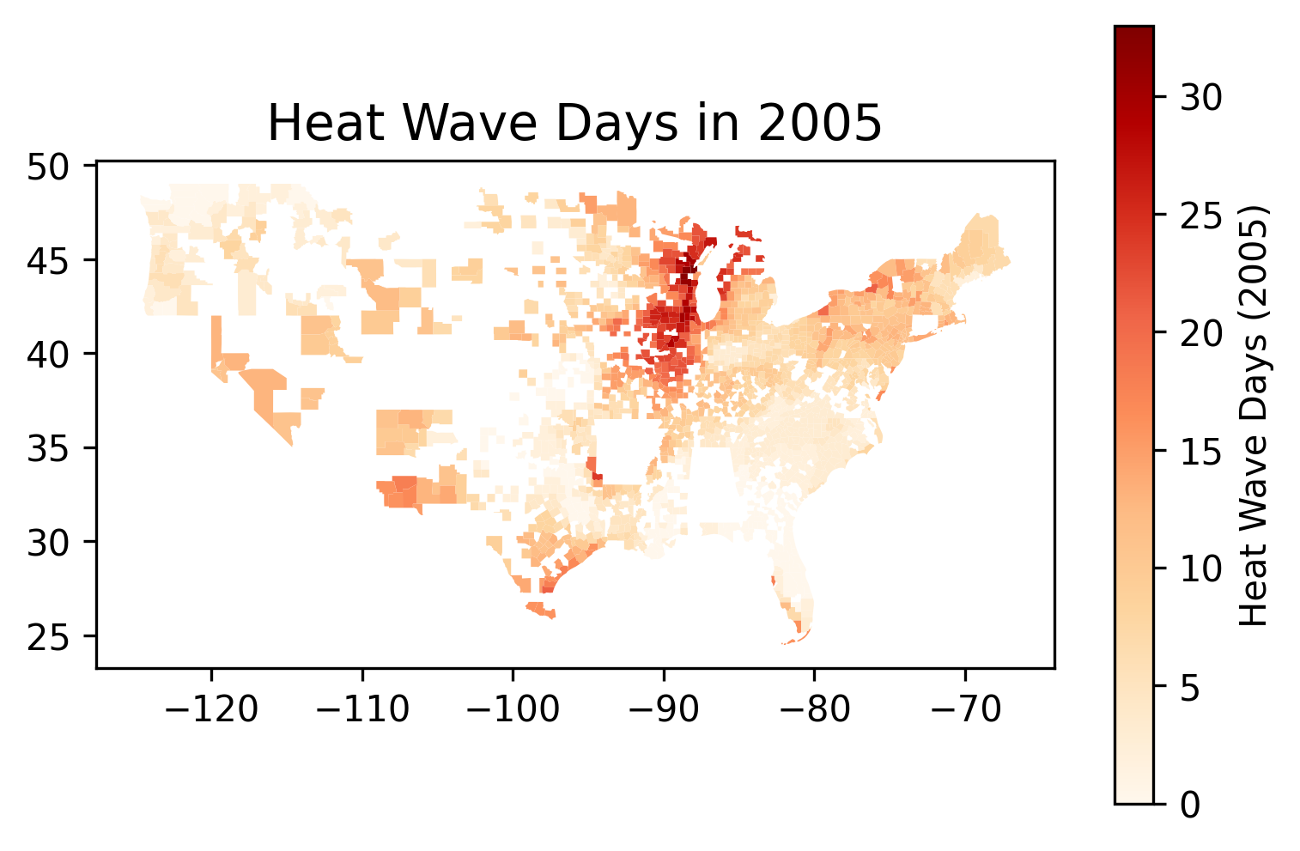
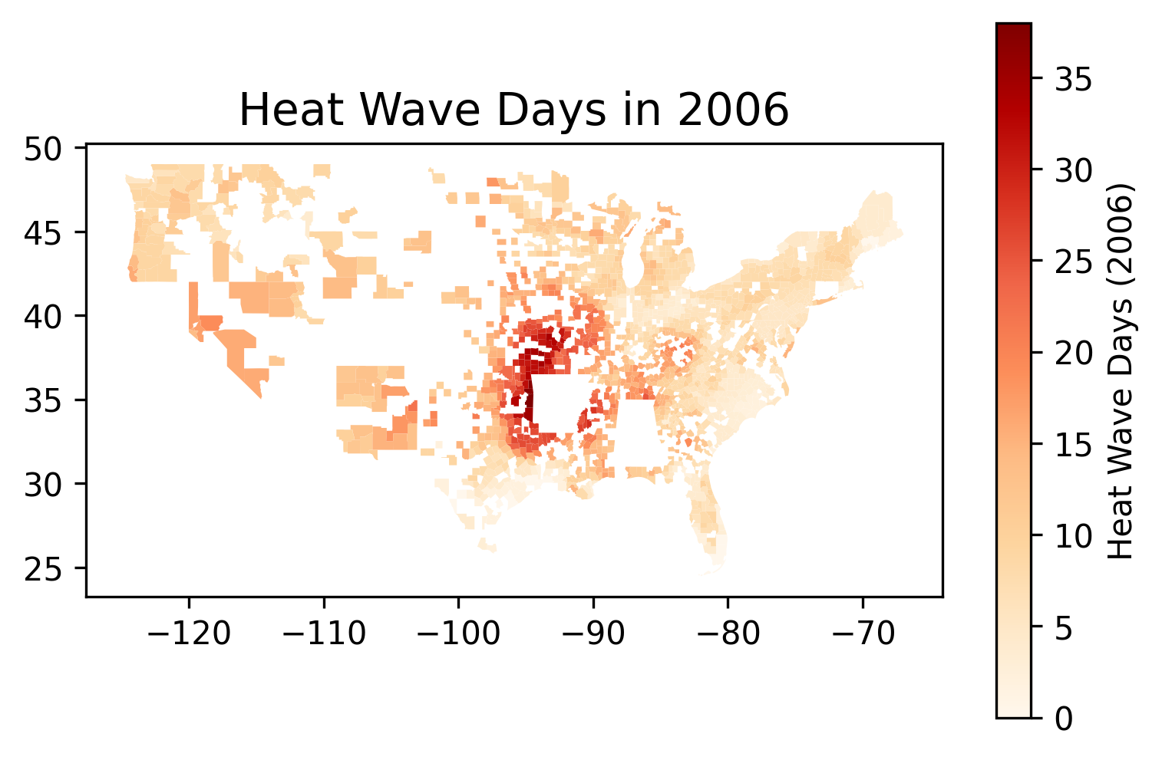
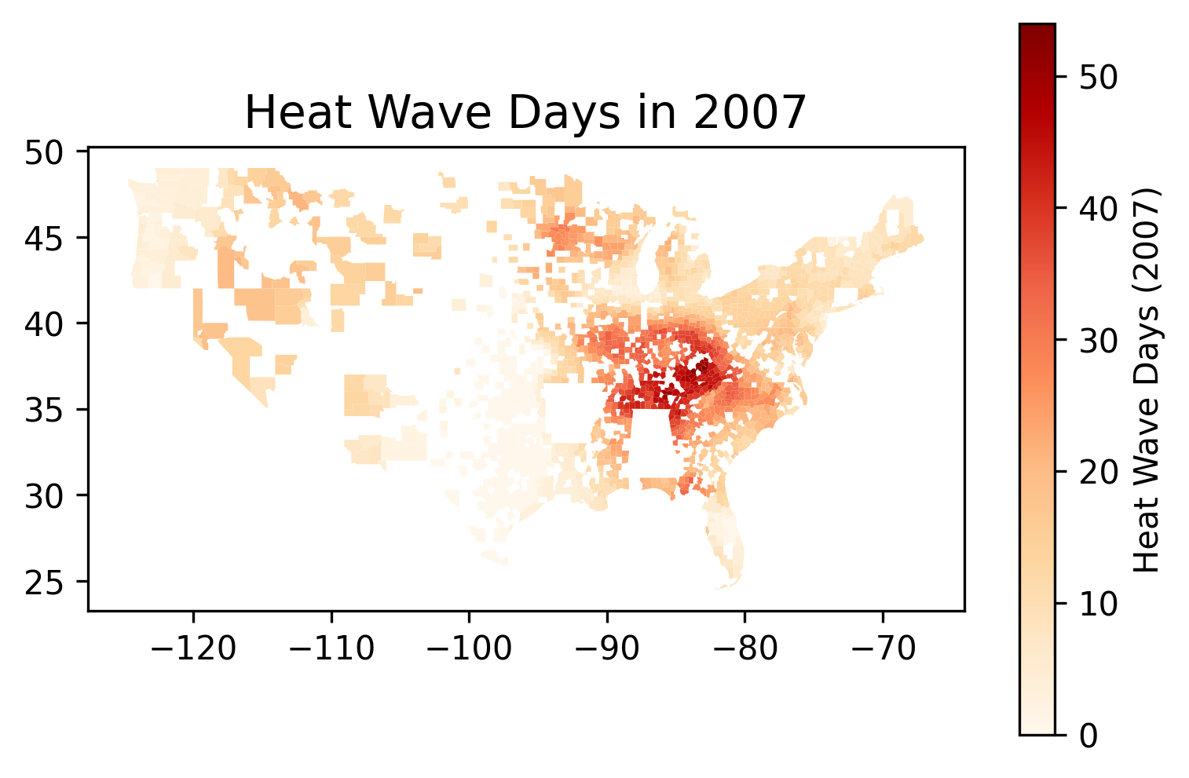
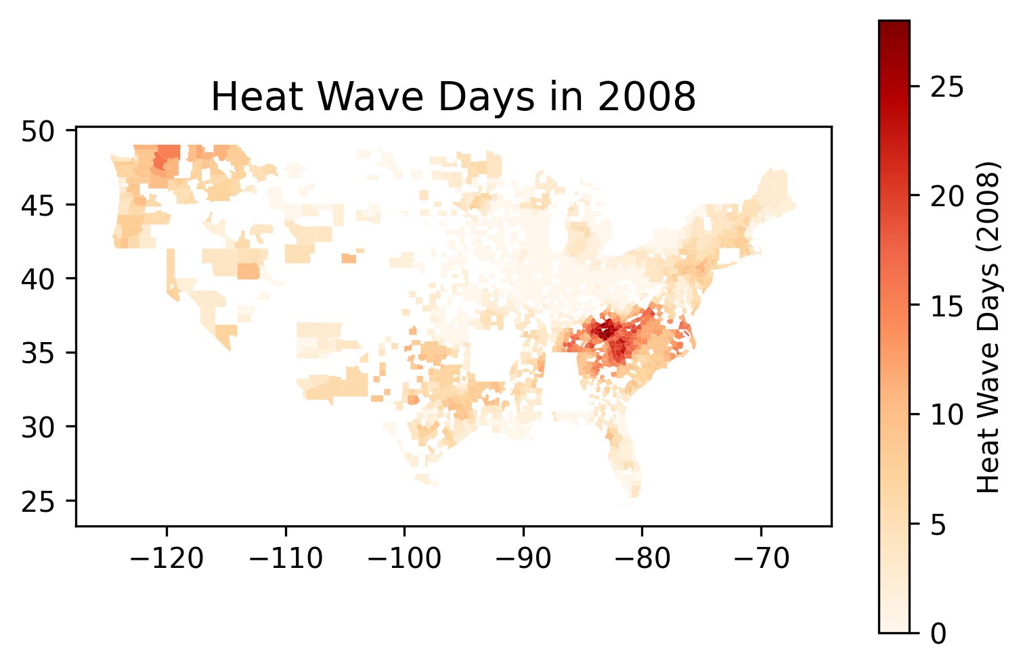
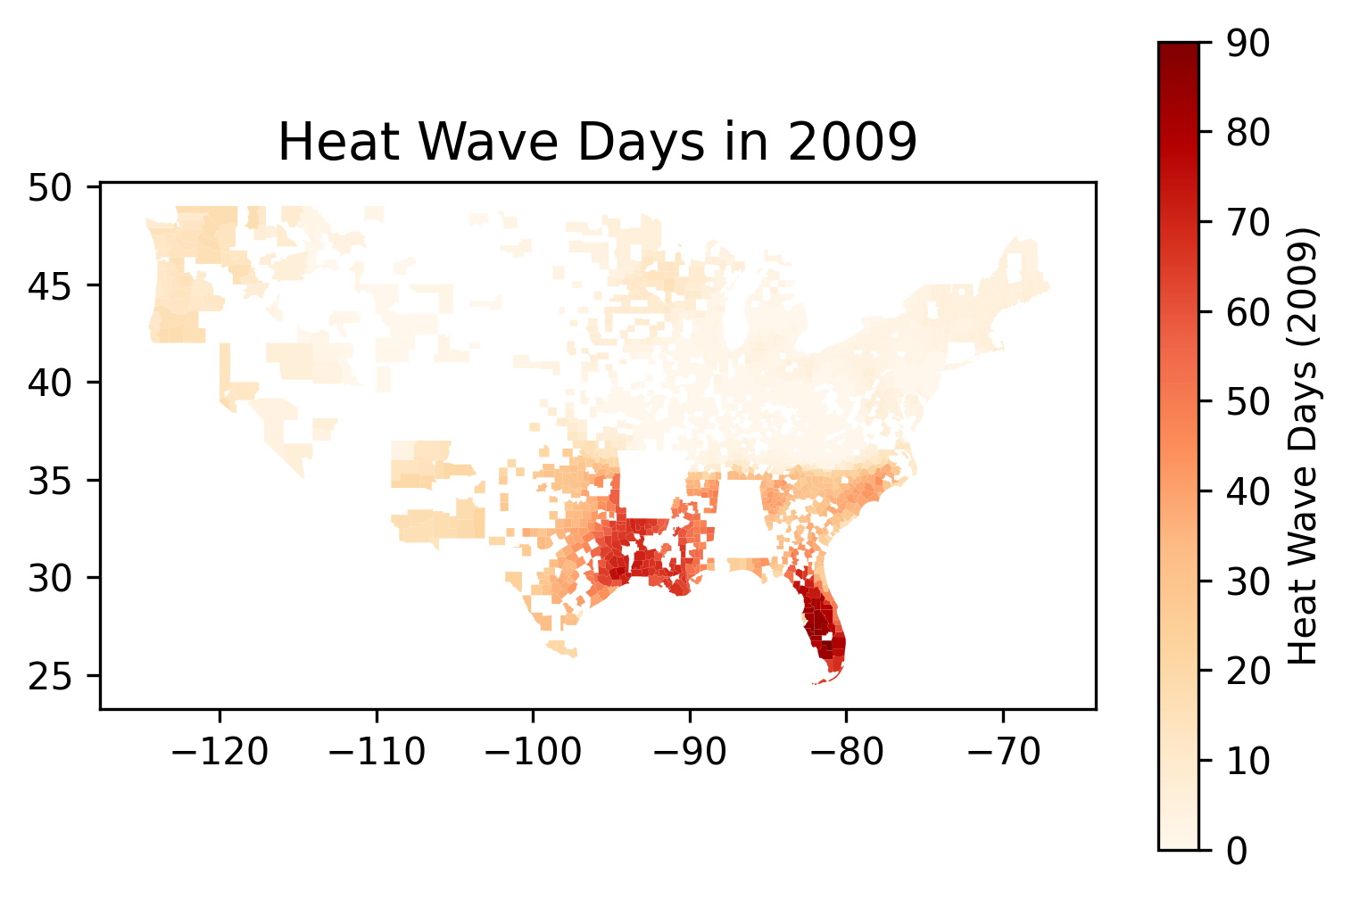
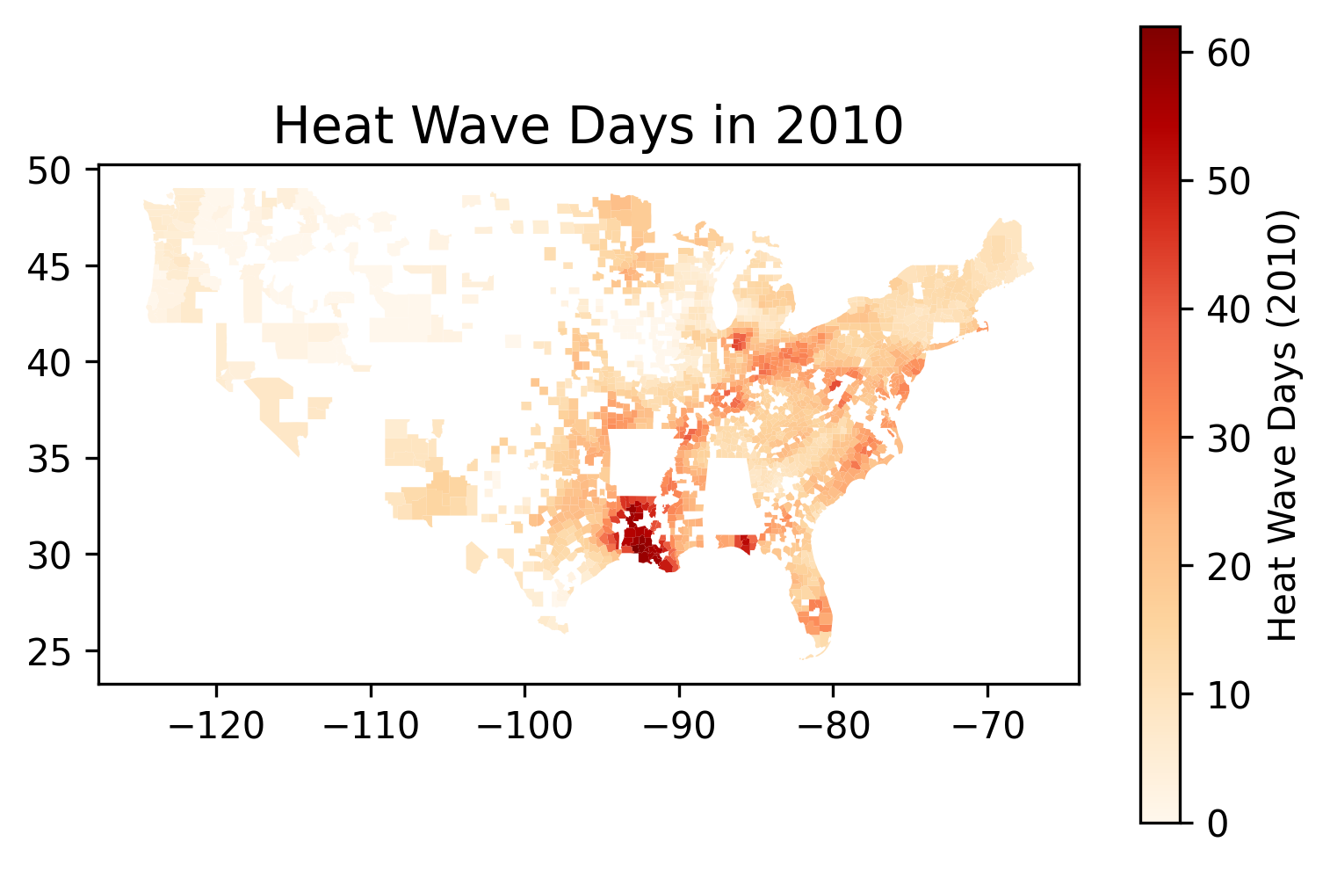
Why do we choose data for 6 years?
-> eliminate the geographic bias
counter intuitive

Slide 7
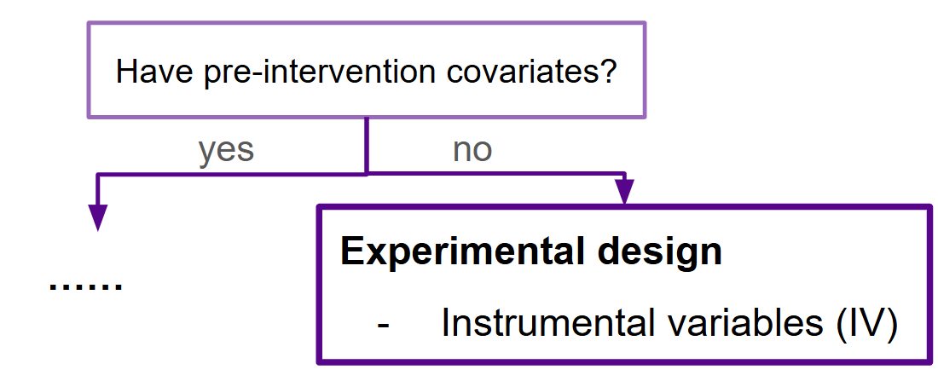
IV Roadmap
Why IV? Who can be IV?
IV Stage
Z: Albedo
X
First stage (Z->T)
Y:
Respiratory death
Second stage (Z->Y)
T: Heat wave days
2SLS
Death ~ C(Year) + Albedo + Heat

Slide 8
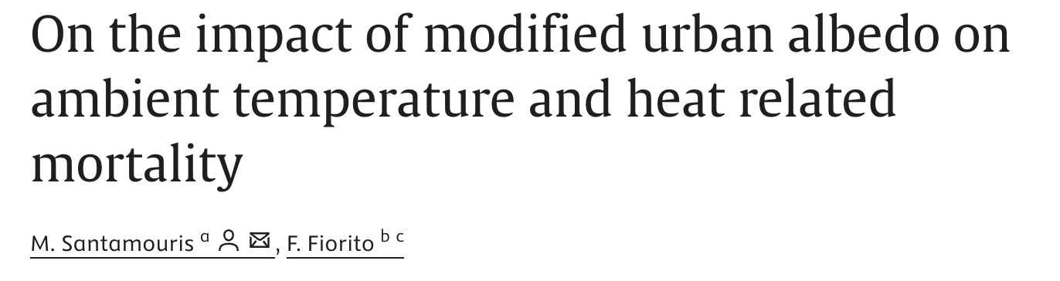
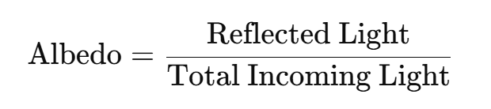
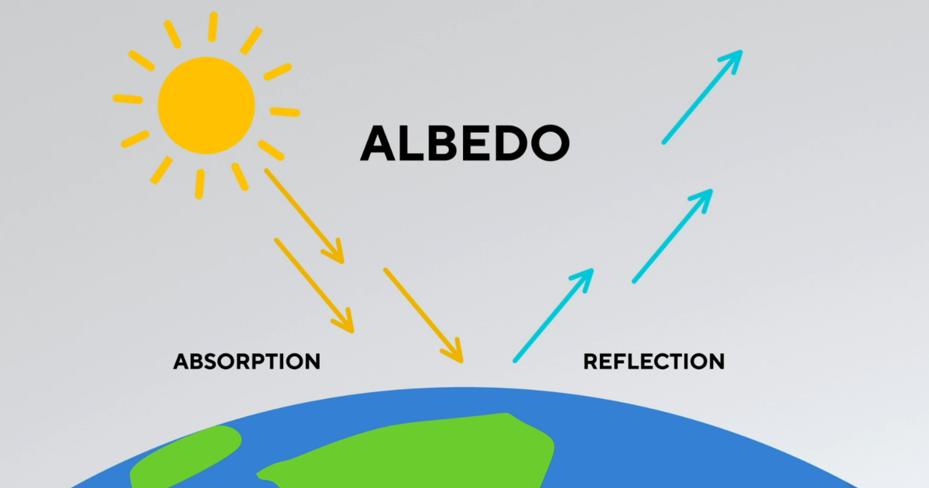
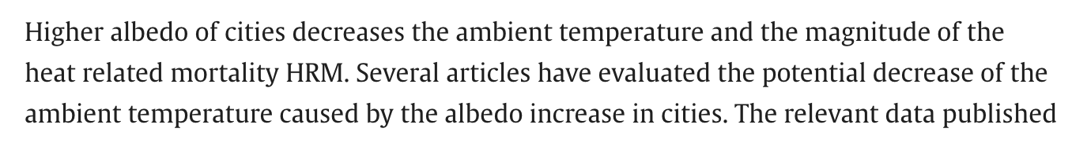
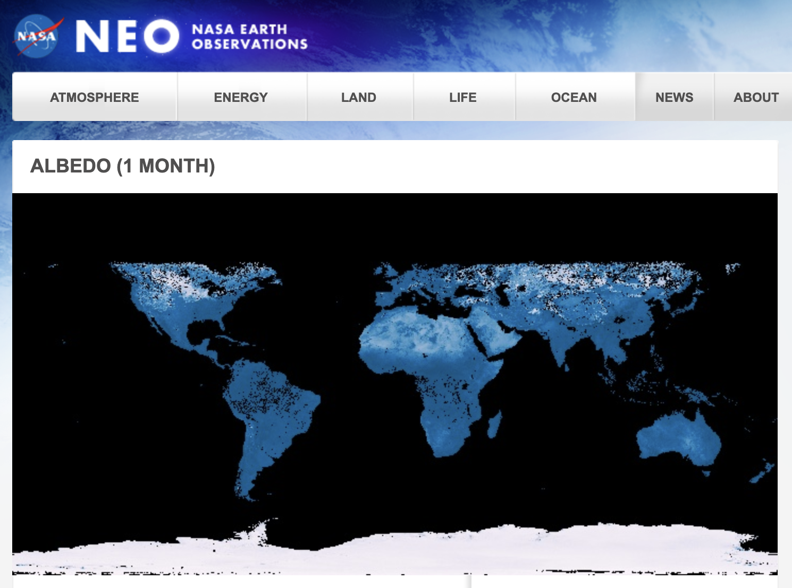
Why IV? Who can be IV?
Z: Albedo
T: Heat wave days
Y:
Respiratory death

Slide 9
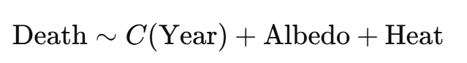
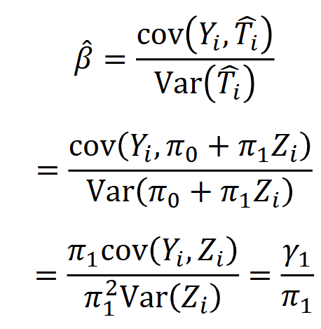
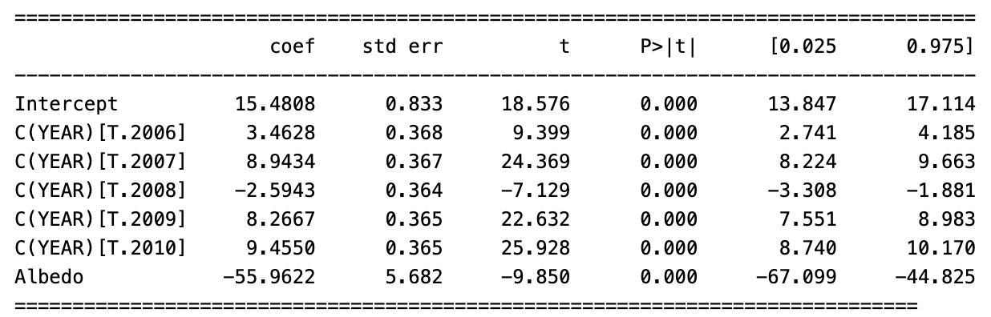
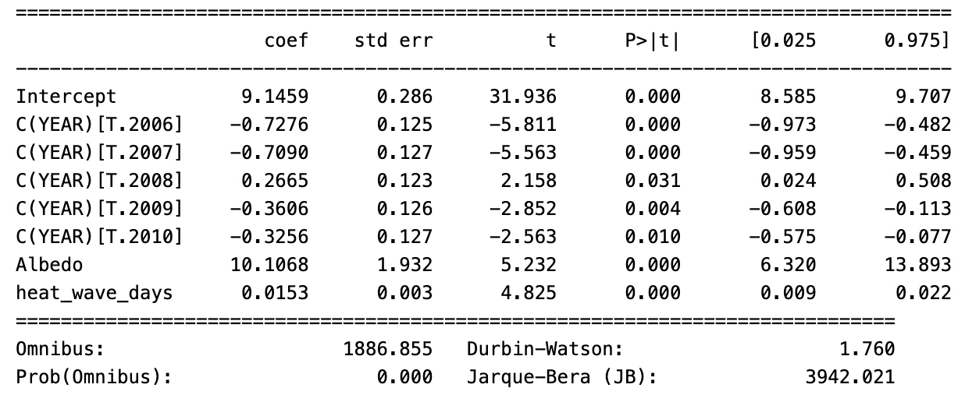

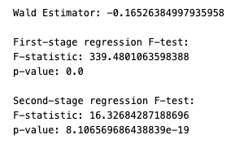
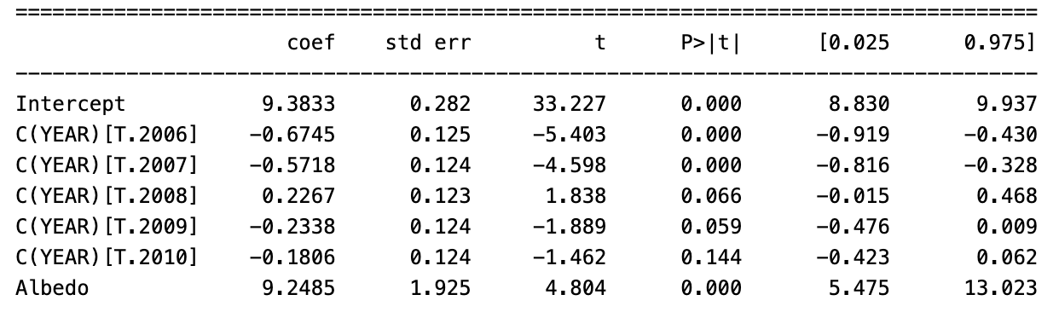
Wald Estimator & IV2SLS
First Stage
NOT GOOD IV
Exclusion restriction
Second Stage

Slide 10
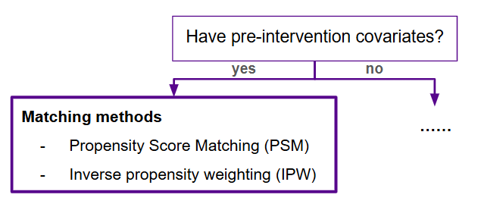
IPW Roadmap
Pollution
Demography
Topography
Healthcare
……
Why IPW? Why polynomial?
X
Feature selection?
take CORRELATION seriously
Y:
Respiratory death
keep FORK confounders
T: Heat wave days
Matching?
Check balance
Balance assessment

Slide 11
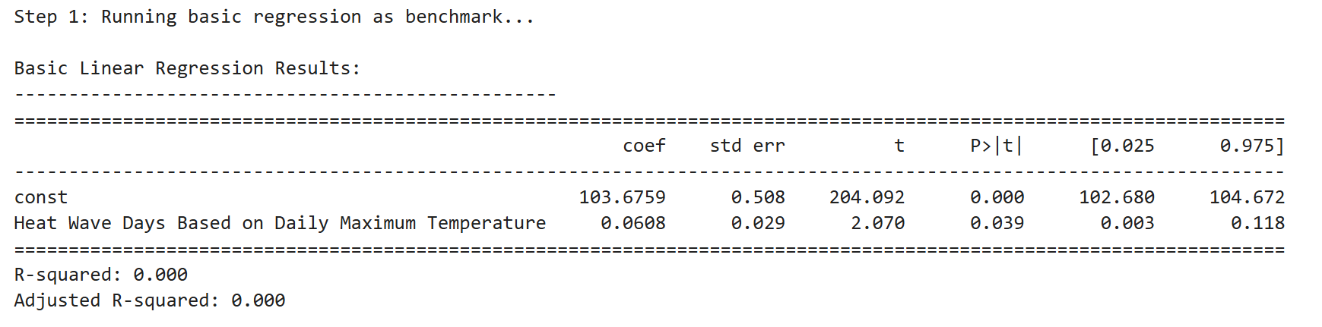
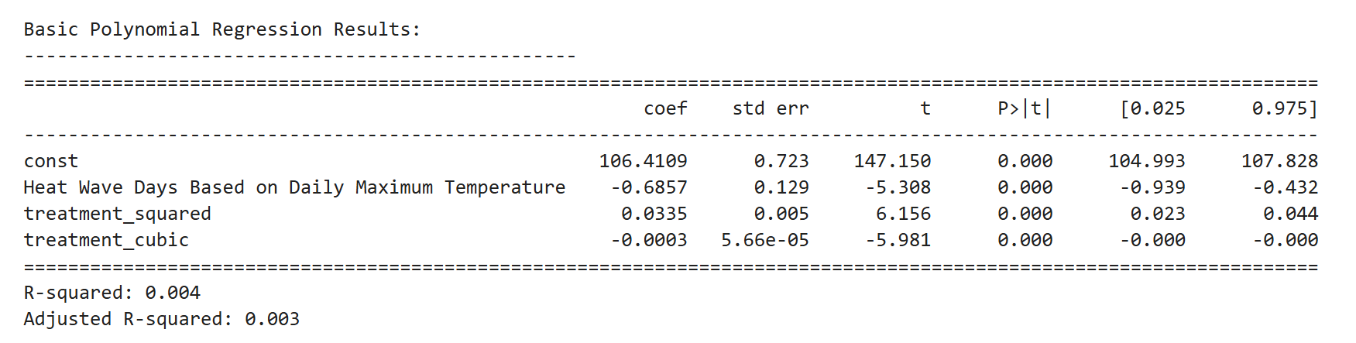
Benchmark: uncontrolled regression analysis

Slide 12
Feature Selection
'% Smokers',
'% Binge Drinking',
'No of Diabetics',
‘PM Days',
'% Healthy Food',
'% unemployed'
eliminate MEDIATOR & COLLIDER
retain key features in multicollinearity
keep STUDY proved
mechanism
features -> features
50
7

Slide 13
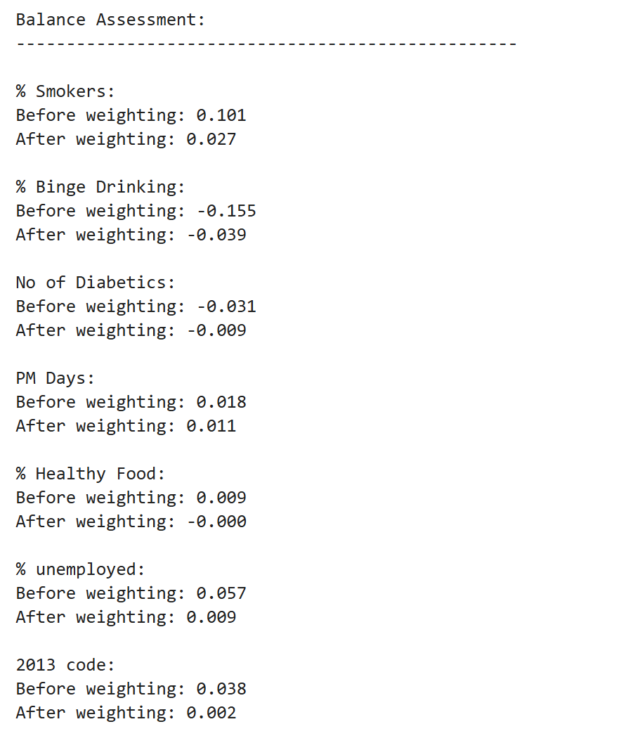
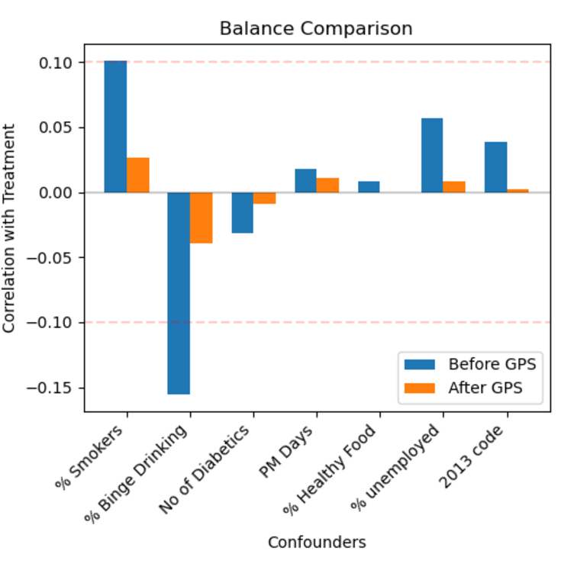
Independence Assessment
Notes:
after matching, we want to minimize the dependence of confounders to treatment

Slide 14
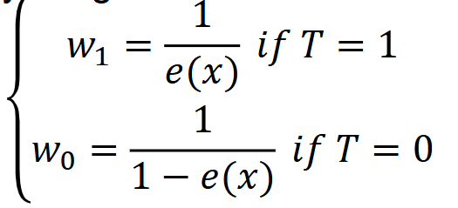
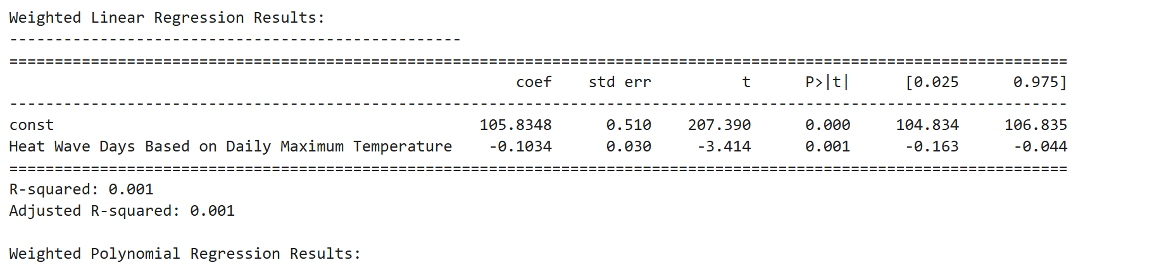

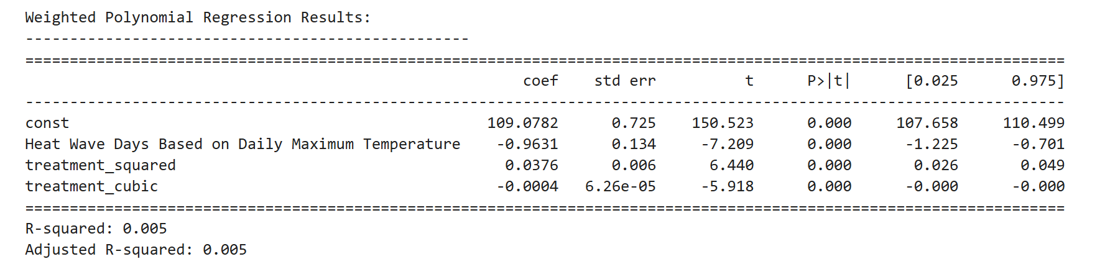
Inverse Probability Weighting (IPW)
who got good P-VALUE!

Slide 15
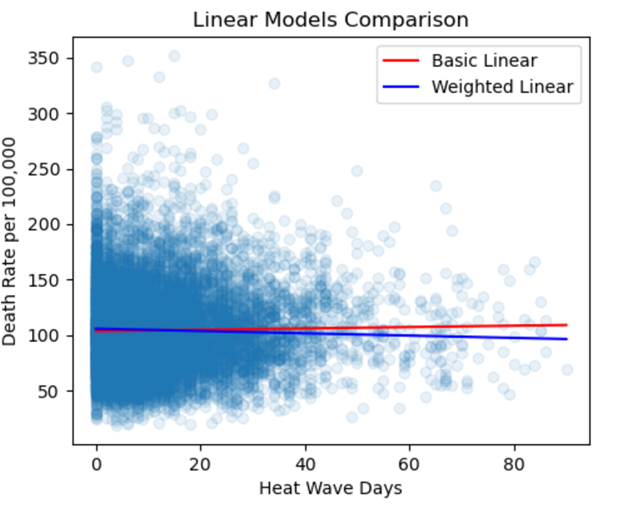
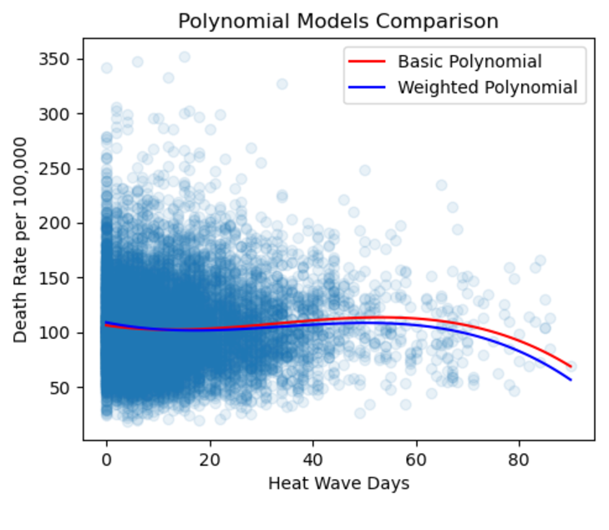
Benchmark v.s IPW
Obvious difference over 40 days

Slide 16
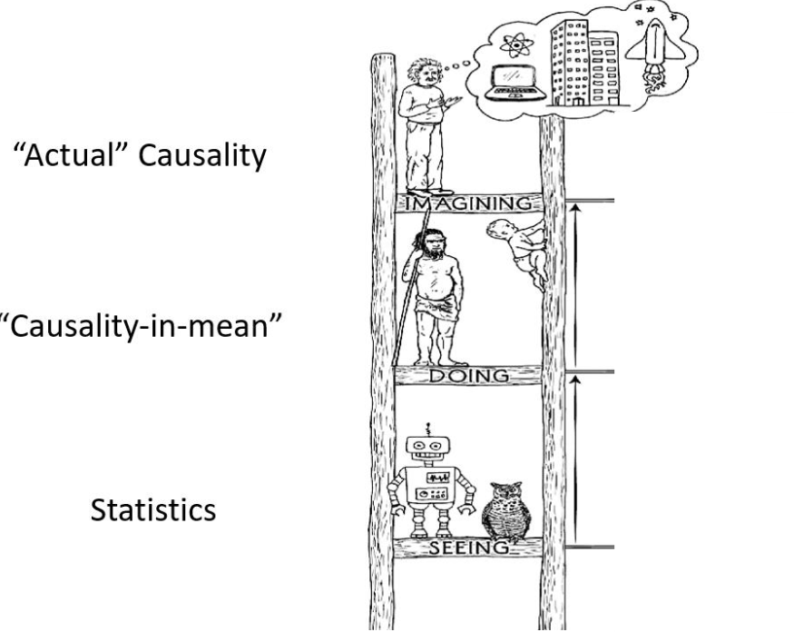
Conclusion
&
Limitations
P A R T 0 3

Slide 17
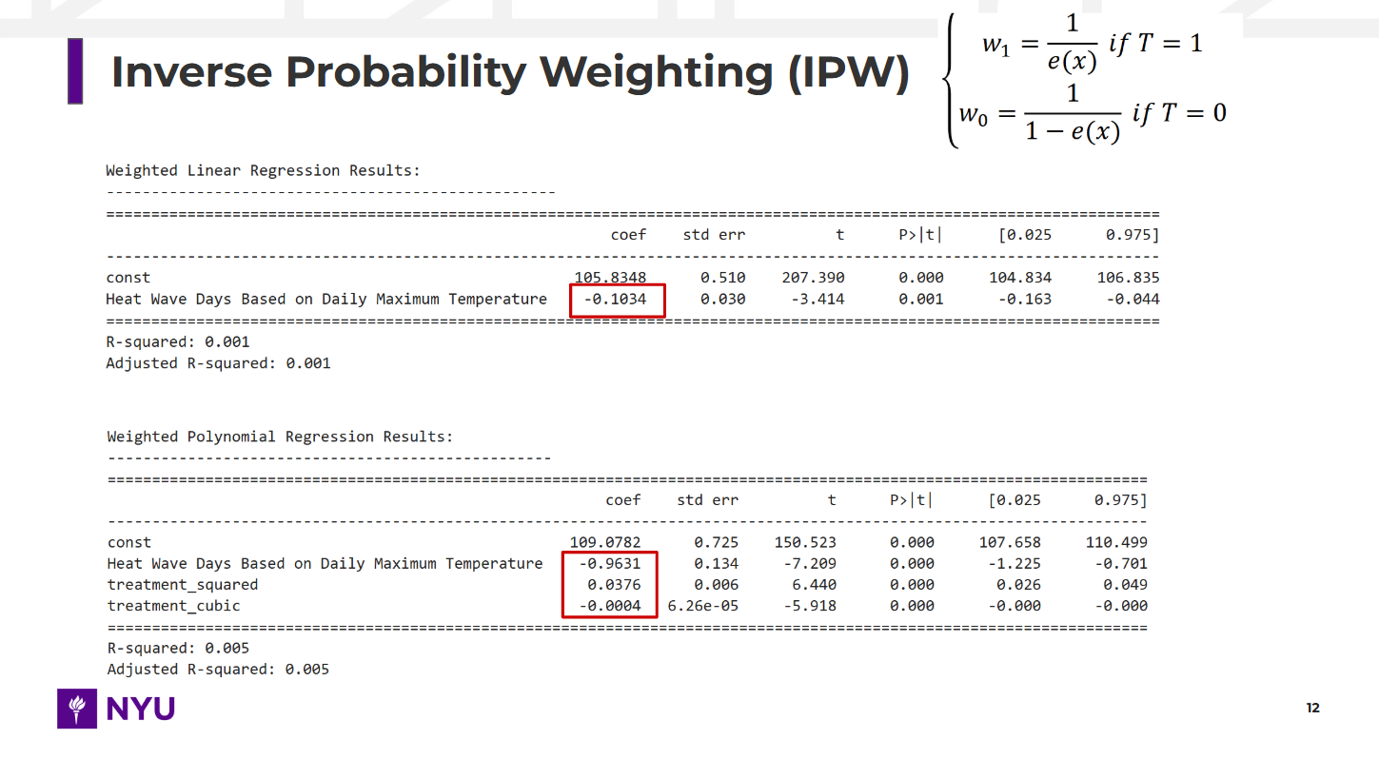
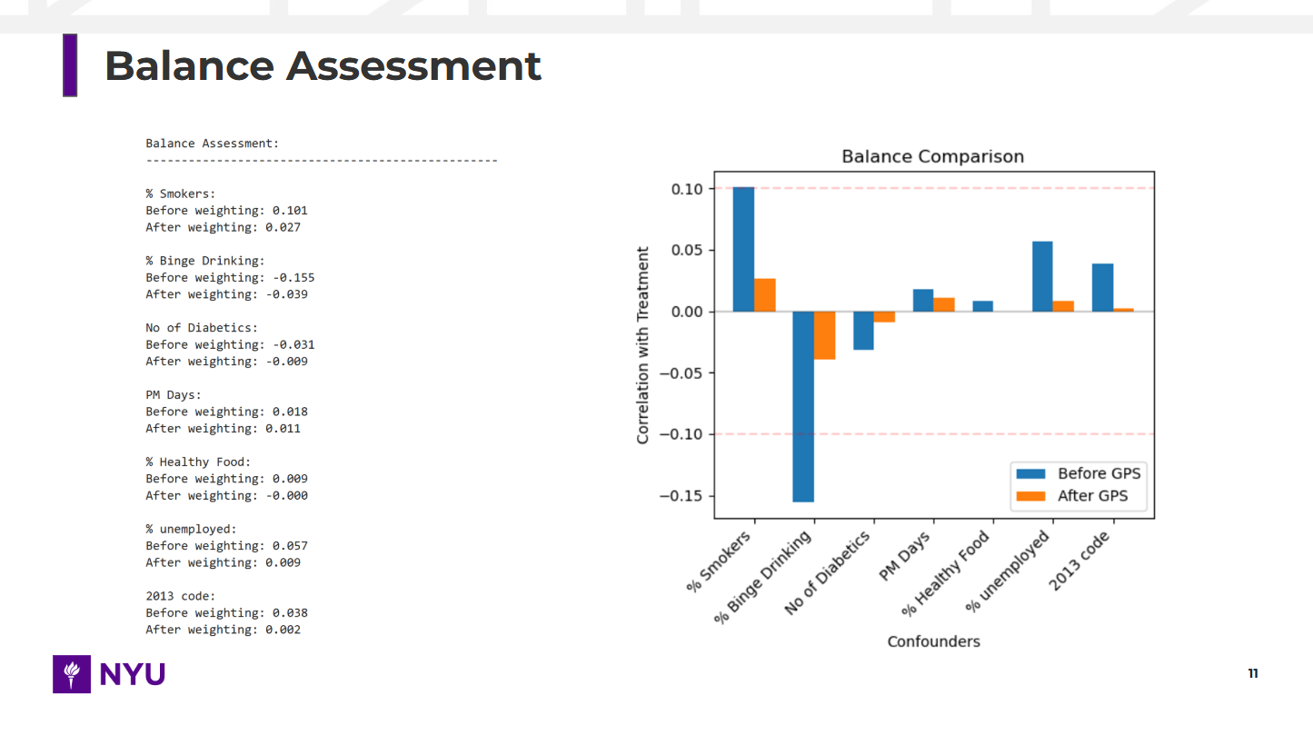
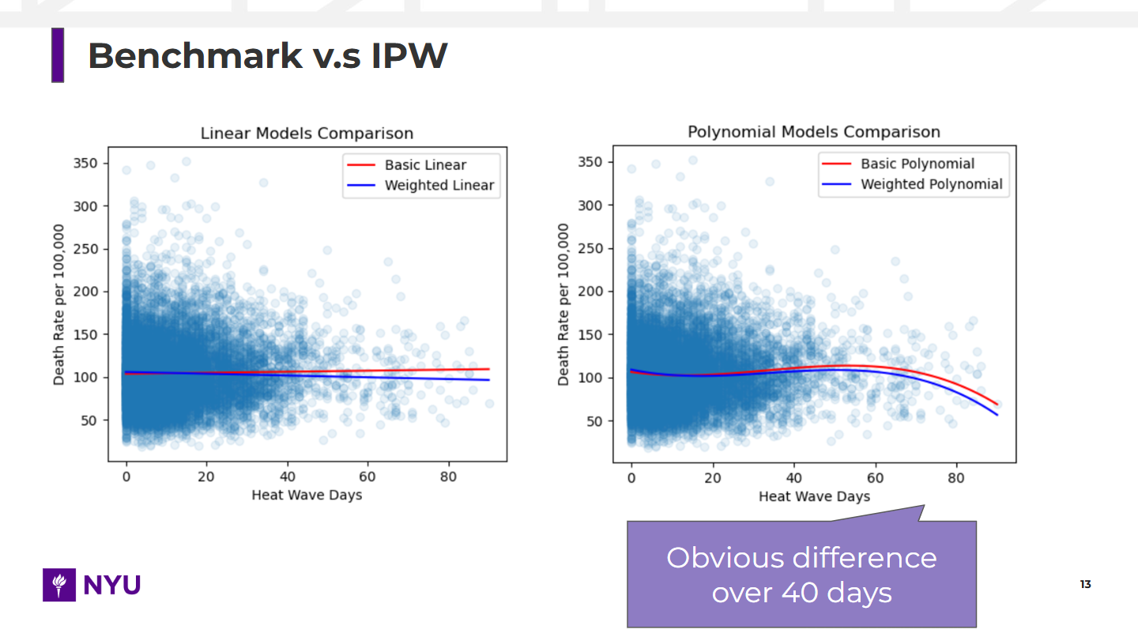
Conclusion
We proved Causation effect of Extreme Heat (T) on Respiratory Deaths(Y), BUT with NEGATIVE results, which are COUNTER-INTUITIVE
IPW
Balance Assessment for Covariate Alignment
Adjustment for Extreme Values
Nonlinear Relationship Captured by the Model
Albedo fails to meet the exclusion restriction, leading to biased results in the Wald estimator and 2SLS.
IV

Slide 18
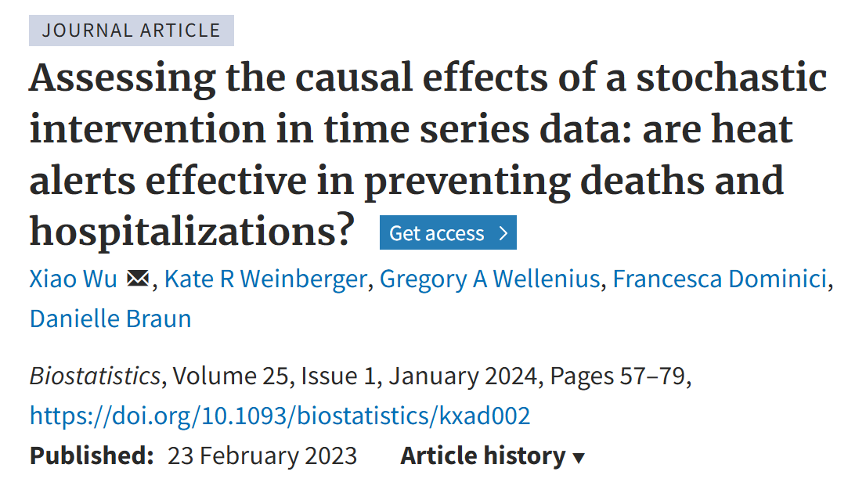

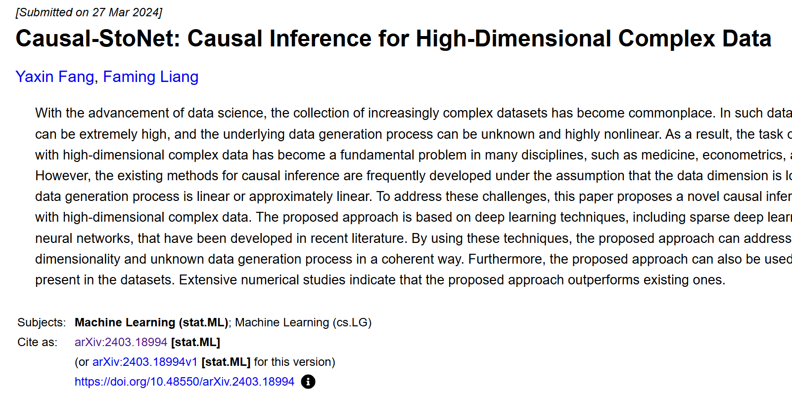
Limitations
PS
…Narrowing down T & Y
PS
TOO MANY
Confounders
Confounder
selection
…High-Dimensional Data

Slide 19



Limitations
p=0
But in
Exclusion restriction
Geospatial
Causal Inference?
A RELATIVELY
Not good IV

Slide 20
Thanks!

